Slide 1
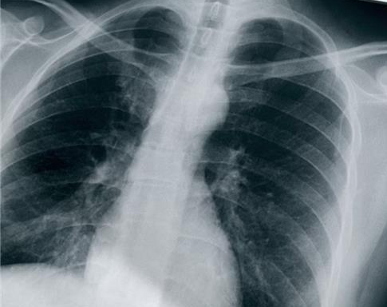
X-ray vision: Extracting diagnostic insights from chest images
Team Members: Sai Akhil Rayapudi
Jayatha Chandra
Lahari Boni

Slide 2
Problem Statement
In medical fields, interpreting X-ray images can be a significant challenge often creating a stressful situation for patients and healthcare professionals alike. Recognizing this, our project aims to harness the power of image processing to provide interpretable insights from chest X-ray images.

Slide 3

Solution Approach
Our project aims to categorize the images into meaningful clusters that represent distinct anatomical and pathological conditions.
This analysis is intended to support medical professionals, improve diagnostic processes, and enhance educational resources.

Slide 4
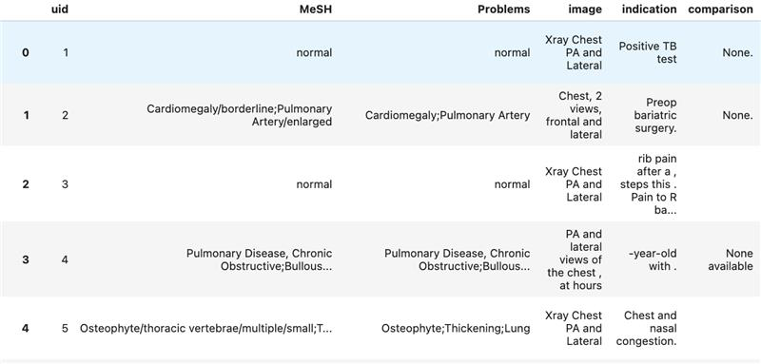
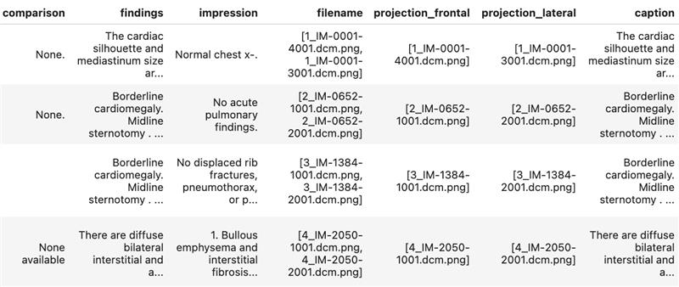
Dataset Description
Title: Indiana University Chest X-Ray dataset
Size: 7,000 chest X-ray images
Two primary components: the radiographic images and two CSV files – one containing the medical reports and the other detailing the image projections.

Slide 5
Technical Methodology
Image Processing and Computer Vision:
Feature extraction from X-ray images using CNN models
K-Means clustering and dimensionality reduction (t-SNE) on image features
Natural Language Processing:
NLP extraction of medical concepts from findings and impressions
Frequency analysis and ranking of extracted terms
Text summarization of prevalent linked terms in findings and impressions
Image Captioning:
Generating caption for the X-ray image by experimenting with VGG, RNN and LSTM models.

Slide 6
Thank you

